Slide 1


AI SME
Your context-aware knowledge Assistant

Slide 2

THE PROBLEM WE ARE SOLVING
Today’s Challenges
Critical technical knowledge is spread across multiple systems
Confluence pages
GitHub repositories
Internal documents
SME tribal knowledge
Engineers and support teams spend significant time searching instead of solving
Answers depend heavily on who you ask, leading to:
Inconsistent responses
Knowledge silos
SME dependency and burnout
Impact
Slower problem resolution
Repeated questions to SMEs
Increased onboarding time for new engineers
Operational inefficiency at scale

Slide 3
WHY SOLVING THIS MATTERS
If We Fix This Problem
We unlock measurable business value:
Faster time-to-answer
Reduce minutes/hours of searching to seconds
Reduced SME load
SMEs focus on complex issues, not repeated questions
Consistent, approved answers
One source of truth across teams
Improved onboarding
New engineers ramp up faster
Better operational resilience
Knowledge survives team changes and attrition

Slide 4
HOW OUR IMPLEMENTATION SOLVES THE PROBLEM
End-to-End Flow ( High level)
Internal documents (Confluence, GitHub, uploads) are indexed
Content is:
Cleaned
Chunked
Converted into semantic embeddings
Stored in a vector DB
User asks a question in natural language
System:
Finds the most relevant internal content
Uses an LLM to generate a grounded response
Answer is returned with context and traceability
Result
Accurate, explainable, enterprise-ready answers

Slide 5
ARCHITECTURE
This architecture enables a secure, enterprise-ready AI assistant that answers questions using internal documentation instead of generic internet knowledge.
Frontend (Browser)
Web UI with Chat and Document Upload
Google Sign-In for authentication
Maintains session state (user, conversations)
Backend APIs
Auth API issues JWT after identity verification
Chat API handles queries and streaming responses
Document API processes and indexes uploaded content
RAG Intelligence Layer
Retriever searches internal knowledge using vector embeddings
Generator produces answers grounded in retrieved context
Prevents hallucinations by design
Storage
PostgreSQL for users and chat history
ChromaDB for semantic search over documents
Authentication & Security
Google OAuth for user identity
JWT-based authorization
Auth Guard protects all backend endpoints
External Services
OpenAI for embeddings and response generation
Google OAuth for authentication

Slide 6
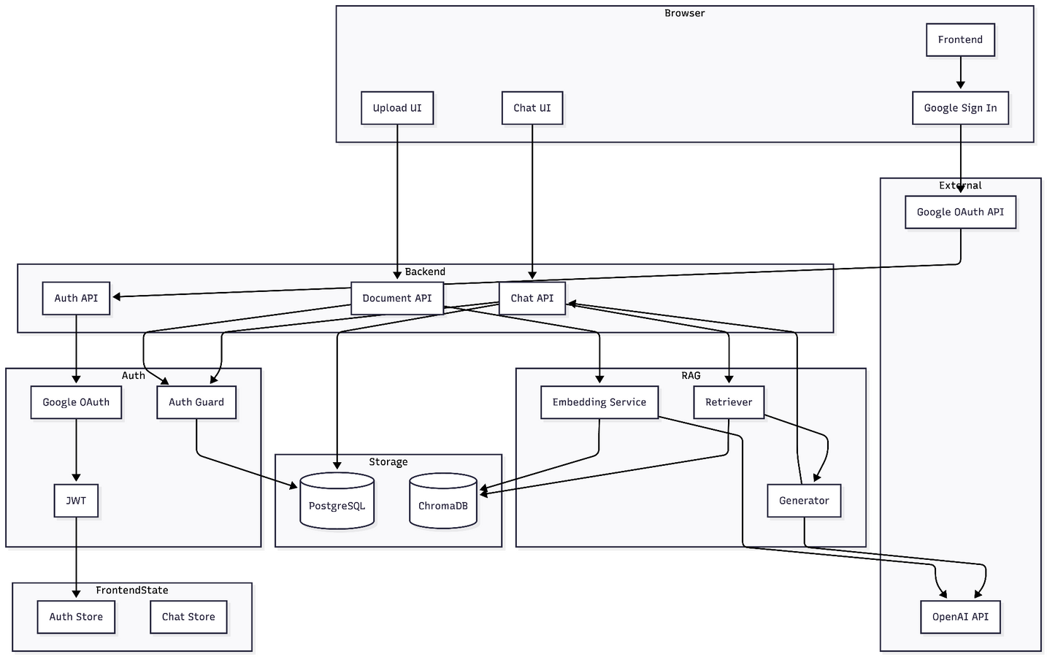
ARCHITECTURE

Slide 7
WHY THIS IS SAFE FOR AN ENTERPRISE BANK
Risk & Compliance Considerations
No training on external data
No uncontrolled internet browsing
Retrieval limited to approved internal content
Auditability via:
Source metadata
Conversation history
Can be extended to:
Logging & monitoring

Slide 8
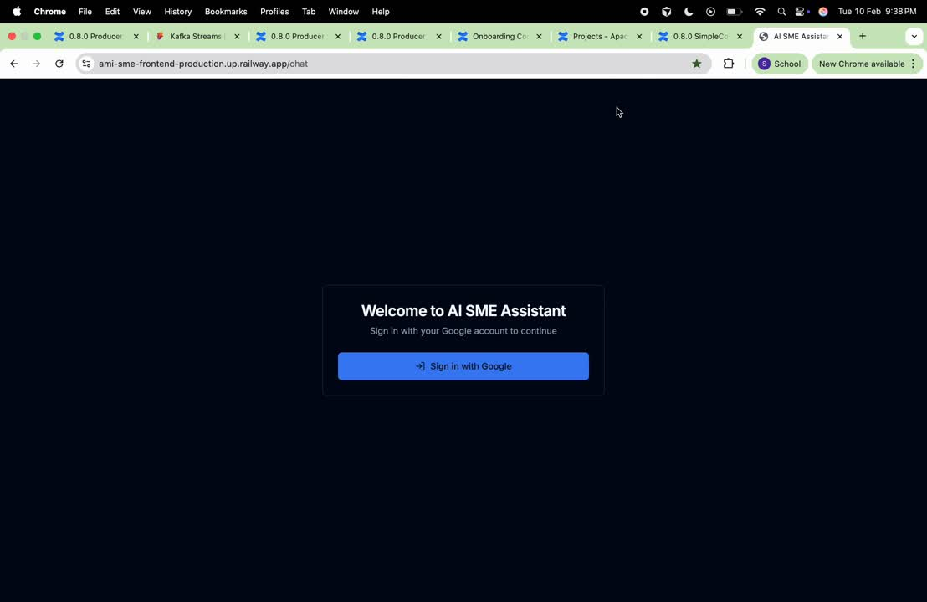
DEMO

Slide 9
LIMITATIONS
Current Limitations:
1. Knowledge Base Scope Only answers questions about indexed documentation/code. If information isn't in the knowledge base, it can't answer.
2. Code Execution: Can't run code or test solutions—only provides information and examples.
3. Real-Time Data: Doesn't have access to live system metrics, logs, or real-time data.
4. Multi-Modal: Can't process images, diagrams, or screenshots (text-only).
5. Complex Reasoning: May struggle with multi-step problem-solving that requires deep code analysis.

Slide 10
REALISTIC FUTURE SCOPE
Short-Term Enhancements
Better source citations
Admin UI for content control
Adding live tracking using splunk and Mongodb
Mid-Term
Integration with:
ServiceNow
Incident management systems
Long-Term Vision
AI SME per team
Cross-domain reasoning
Predictive insights from operational data

Slide 11
Thank you.

